Slide 1
Allegra Spender’s Tax White Paper
Personal Income Taxation Reform

Slide 2
Intergenerational inequity the guiding concern
Delayed milestones
Rising tax rates
Role of low productivity
Home buying and raising a child –things that young people are delaying relative to earlier generations.
Also less entrepreneurship and business formation.
Average tax rate has risen over past 20 years.
Rising average income tax rates through time mean current cohorts face a higher tax rate.
Older people paying “lower tax rates” due to how they earn their income.
Low productivity reduces income growth for the currently young (reduces value of human capital).
Tax stopping investment in skills.
Tax stopping investment in physical capital.
Takeaways:
Tax system can and should address this by: i) redistributing from the currently older ii) neutralizing distortions.
Capital is taxed at lower rates than labour income – when we should treat a dollar as a dollar.
But spending restraint also needed to reduce average tax rates – so tax package is “revenue-neutral”.
2

Slide 3
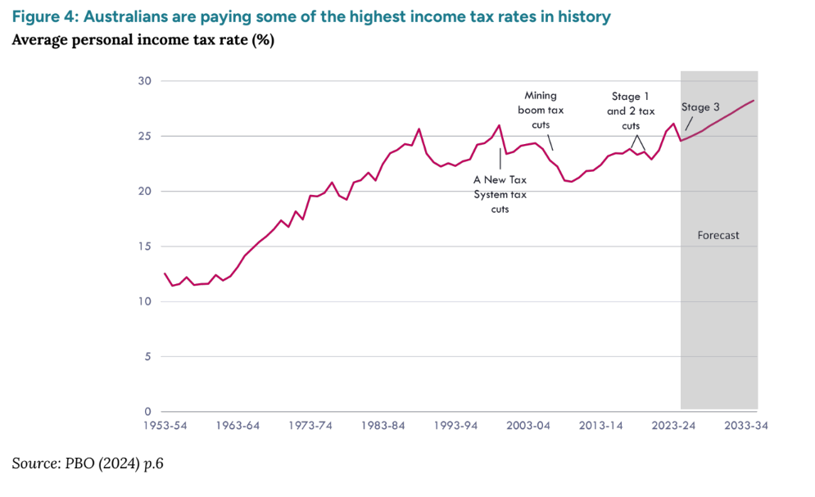
Proposals
Funding this
Minimum tax rate on capital income
27%, no tax-free threshold
Trust and super reforms
Super, higher tax rates on accumulation once over $1m.
Making work pay
Cut capital gains discount
33%, ringfencing (all non-labour earnings)
Cut income tax rates
2.5ppt drop across the scale (3 at bottom only really 1)
Working income tax credit
Differentiates labour and capital earnings

Slide 4
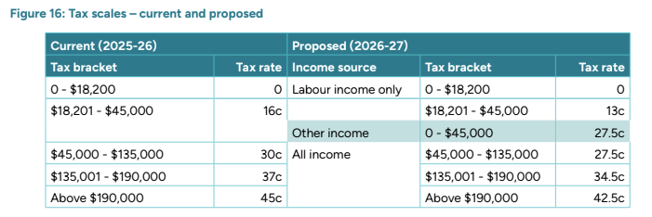
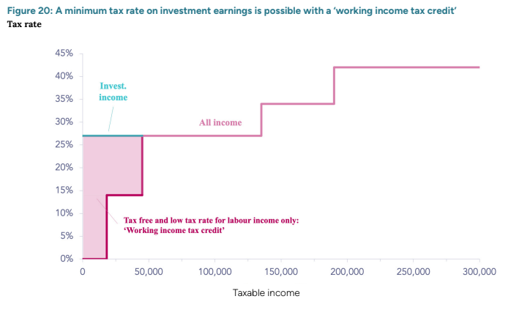
New tax scale

Slide 5
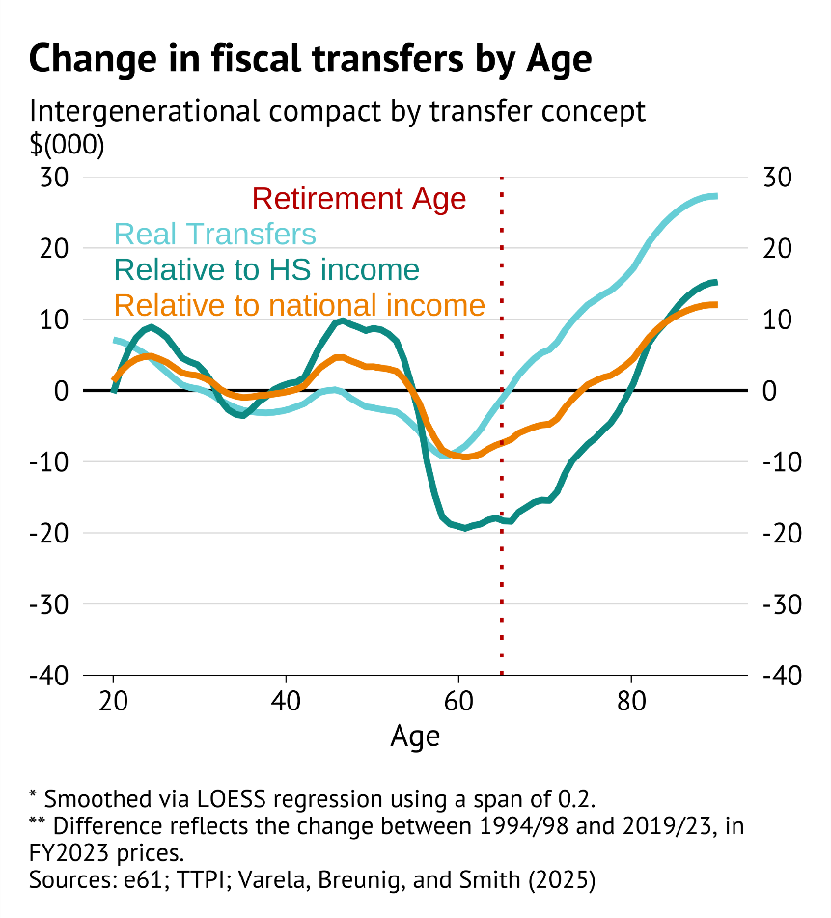
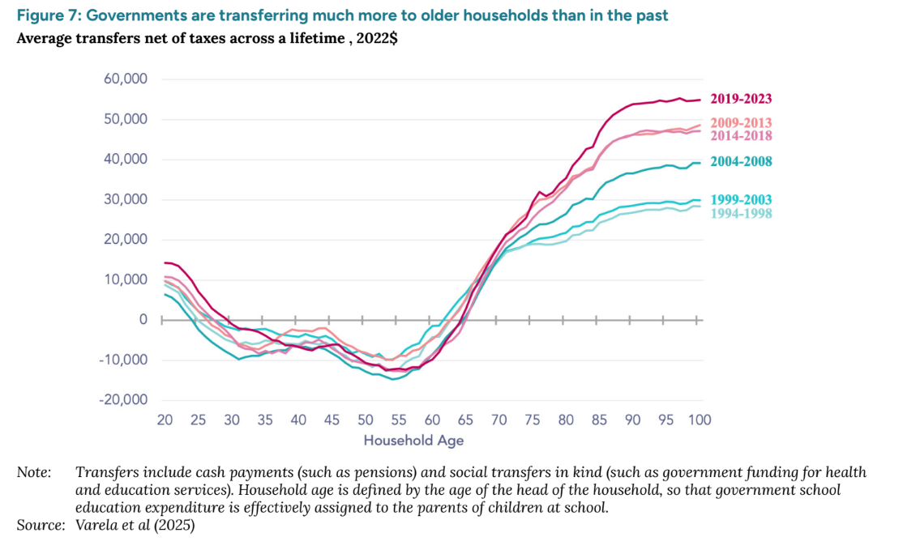
About intergenerational inequity
Important issue. However, it is also complicated.
How much are delayed milestones a product of increased longevity risk? (e61 2025)
How does the intergenerational transfer change if we think in terms of shares of GDP vs real amounts?
Productivity key (next slide)
5

Slide 6
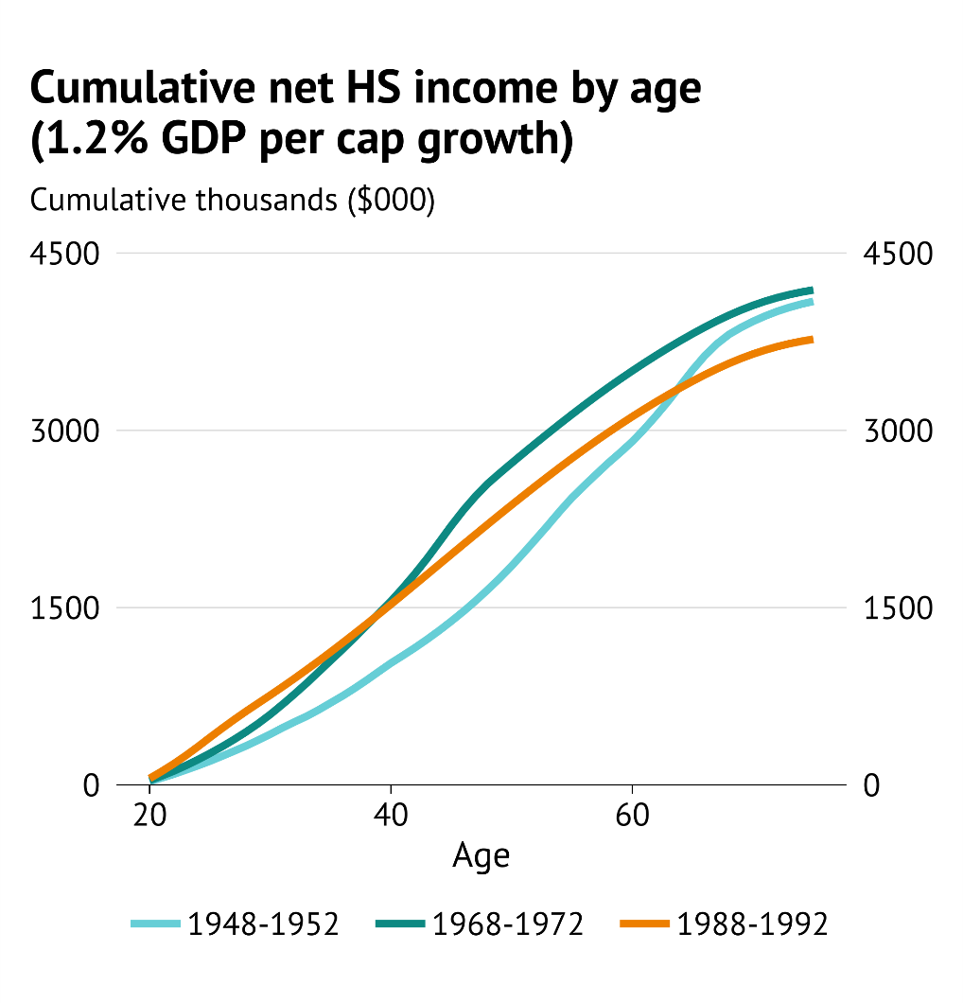
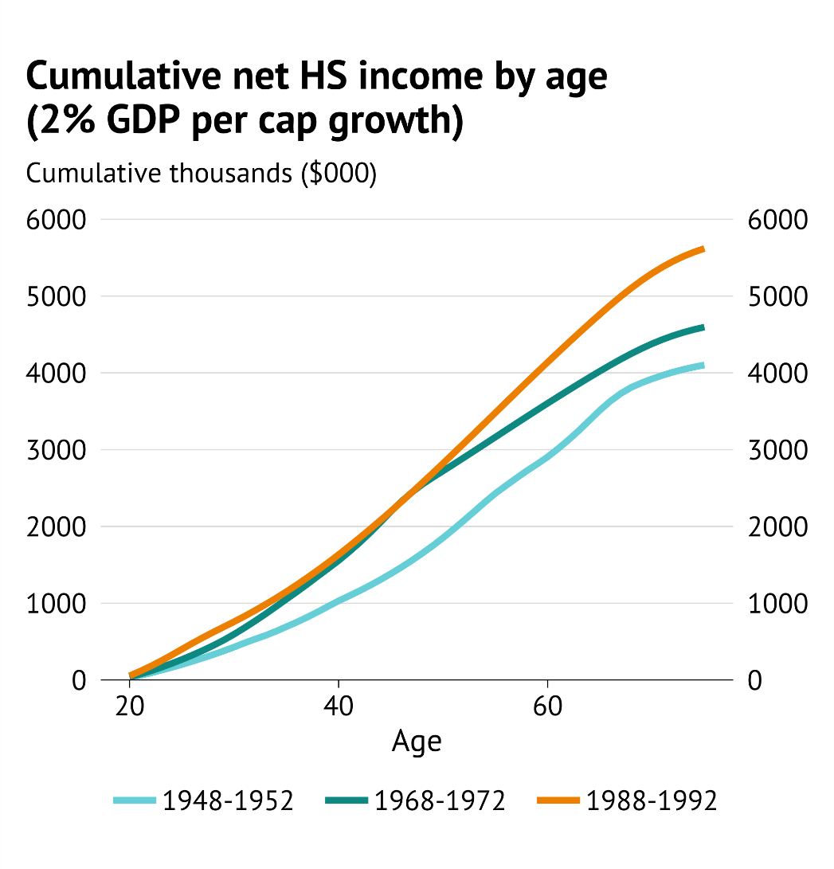
About intergenerational inequity
Intergenerational transfers are a product of r < g. Is our concern that this has flipped?
Productivity outcomes are key for a view on this.
6

Slide 7
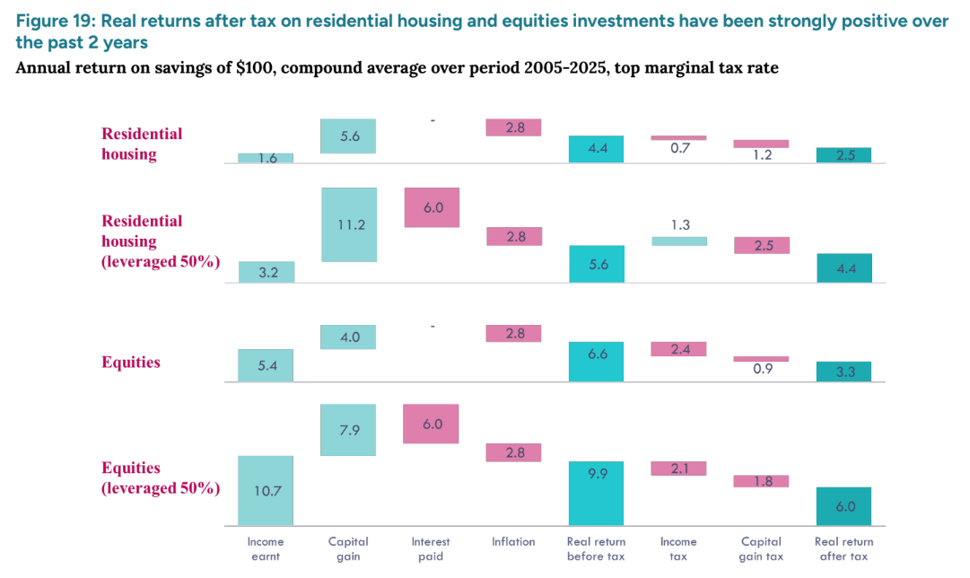
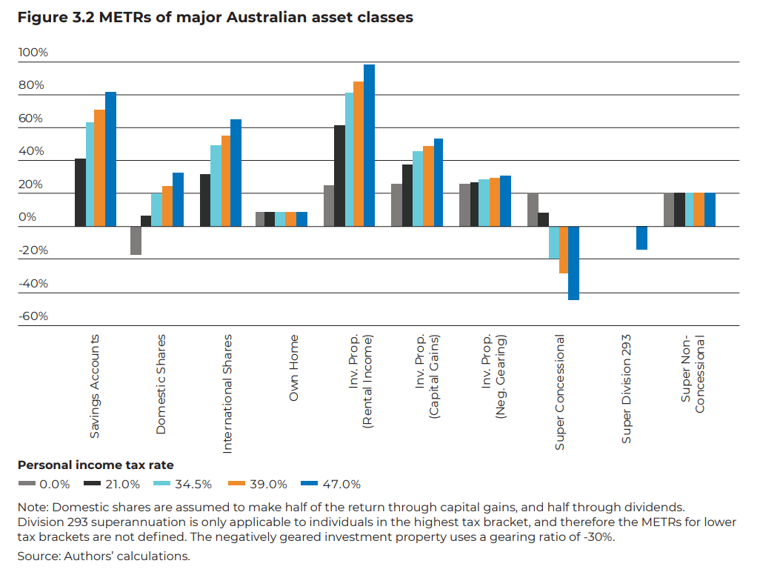
About the relative taxation of labour and capital
Say we agree that labour and capital should be taxed at the same rate. Is the current system concessionary?
https://crawford.anu.edu.au/sites/default/files/2025-04/20271%20ANU%20-%20TTPI%20Policy%20Report-FF%5B2%5D.pdf
This view of real is without applying Atkinson-Stiglitz (1976).
This would recommend non-taxation of the normal rate of return, and so lower rates.
Same logic “sacrificing the use of a dollar to consume now, opportunity cost is risk-free rate.”
7

